Slide 1
GirlSMART All Staff Conference Call
Gibson & Associates
Monday, November 21, 2011

Slide 2
Purpose
To bring the national team together to discuss program progress and goals.
Thank you for all your time, work, and energy.

Slide 3
Agenda & Agreements
Gibson & Associates Data Summary
(20 min.)
Observation Findings
Demographics & Assessment Data
Discussion (30 min.)
Common Needs
New and Exciting! (10 min.)
GirlSMART
Website
Sharing Resources
SSB Images Contest
Appreciations & Closing
We agree to
Be open
Listen
To stay on time

Slide 4
Fall Observation Findings

Slide 5
Demographics Analysis

Slide 6
Students by Grade-Level

Slide 7
Students by Ethnicity

Slide 8
Ethnicity of Students by Location

Slide 9
Household by Location

Slide 10
New vs. Returning Students by Site

Slide 11
Fall Assessment Data

Slide 12
Determining Benchmark Status

Slide 13
Fall Assessment Schedule
Assessment | Grade
Initial Sound Fluency | PK, K
Letter Naming Fluency | K, 1st
Phoneme Segmentation Fluency | 1st
Oral Reading Fluency | 2nd, 3rd
Retell Fluency | 2nd, 3rd

Slide 14
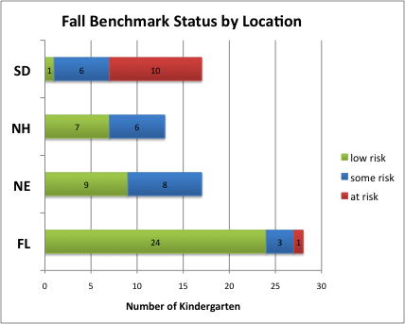
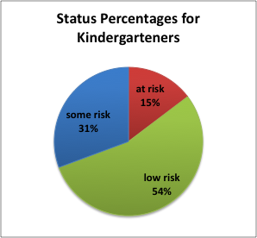
Initial Sound Fluency (ISF)
Who was assessed?
Assessment administered to K and PK students in fall.
Fall Benchmark information is available for K only.
What does this assessment measure?
ISF assesses a child’s skill at identifying and producing the initial sound of a given word.
ISF is a measure of phonemic awareness, in conjunction with the phonemic segmentation fluency subtest (PSF).
How did we determine risk level?
At risk: 0 – 3 correct sounds in 1 minute
Some risk: 4 – 7
Low risk: 8+
What does each category mean?
At risk: students should have intensive support in developing phonemic awareness.
Some risk: students may need individualized instructional support for some aspects of the development of phonemic awareness
Low risk: students are considered on track for the development of phonemic awareness.

Slide 15
Letter Naming Fluency (LNF)
Who was assessed?
Assessment administered to K and 1st grade students for fall.
What does the assessment measure?
LNF assesses a child’s skill at identifying as upper or lower case letters in random order in one minute.
It measures the degree of development of the alphabetic principle: for each speech sound or phoneme in an alphabetic writing system, there is a specific graphic representation in the form of alphabet letters.
How did we determine each category?
At risk: lowest 20th %tile of student norms.
Some risk: 20th – 40th %tile
Low risk: above 40th %tile
What does each category mean?
At risk: students should have intensive support in developing the alphabetic principle and phonemic awareness.
Some risk: students may need support in solidifying understanding of the alphabetic principle.
Low risk: students are considered on track for the development of the alphabetic principle.

Slide 16
Phonemic Segmentation Fluency (PSF)
Who was assessed?
Assessment administered to 1st grade students for fall.
What does the assessment measure?
PSF assesses a child’s skill at at producing the individual sounds in a given word.
It has been found to be a good predictor of later reading achievement.
How did we determine each category?
Deficit: 0 - 9
Emerging: 10 - 34
Established: 35+
What does each category mean?
At risk: students should have intensive support in developing phonemic awareness.
Some risk: students may need individualized instructional support for some aspects of the development of phonemic awareness
Low risk: students are considered on. track for the development of phonemic awareness

Slide 17
Oral Reading Fluency (ORF)
Who was assessed?
Assessment administered to 2nd and 3rd grade students for fall.
What does the assessment measure?
ORF assesses a child’s skill at reading connected text in grade-level materials.
It is designed to identify children who may need additional instructional support as well as monitor students’ progress toward instructional goals.
How did we determine each category?
At risk: lowest 20th %tile student norms.
Some risk: 20th – 40th %tile
Low risk: above 40th %tile
What does each category mean?
At risk: students should have intensive support in developing fluency and word recognition.
Some risk: students progress should be monitored to continue meeting subsequent goals for fluency and accuracy.
Low risk: students are considered on track for the development of fluency and accuracy.

Slide 18
Retell Fluency (RTF)
Who was assessed?
Assessment administered to 2nd and 3rd grade students for the fall.
What does the assessment measure?
RTF assesses a child’s understanding of verbally read connected text.
Its measure is used as an indicator of reading proficiency in two ways:
Prevent practicing or inadvertently learning a misrule.
Identifying children whose comprehension does not match their fluency.
How did we determine each category?
At risk: below 25% of ORF score
Some risk: 25% – 50% of ORF score
Low risk: above 50% of ORF score
What does each category mean?
At risk: students should have intensive support for comprehension.
Some risk: students may need support for acquiring comprehension skills.
Low risk: students are considered on track for the development of comprehension of verbally read text.

Slide 19
Recommendations
Support students who are at risk by providing additional instruction using WTW differentiation or volunteers/aides for one-on-one assistance.
Kindergarten - Provide lots of opportunities for students to recognize sounds of letters during WTW and Read Aloud lessons and activities.
1st grade – Incorporate practice of chunking strategies into WTW and Read Aloud activities to build phonemic awareness.
2nd and 3rd grade - Continue to provide rich opportunities to practice comprehension skills during Read Aloud lessons, and begin to shift focus towards reading fluency skills through Reader’s Theater.

Slide 20
Common Needs
WTW Protocols and Procedures
Integrating Strong Smart Bold into Read Aloud
Book Choice for Read Aloud
Creating visuals to support key vocabulary
Using volunteers/aides to support learners

Slide 21
www.girlsmart.org
Public Face of the Organization
About Us
Program Model
Locations
Staff Community
Forum
Resources
Calendar
Communication

Slide 22
Sharing Resources
Lesson Sharing:
Two successful lessons from each state
Upload to Staff Forum – Feb 1, 2012
Book list recommendations
Email to Jean
Title, Author, Quality of SSB Integration, Appropriate Grade
Questions and Advice on Staff Forum

Slide 23
Images of SSB
Images contest to support qualities of Strong Smart Bold
Winning images will:
Define each quality clearly
Staff created
Developmentally appropriate for girls 4 – 8
Meet the needs of girls from different backgrounds
Please Submit to Pat Loomes & Jean Simpson by Feb 1, 2012

Slide 24
Appreciation & Closing
Any further questions?
gia@gibsonandassociates.com

